Slide 1
1920’s
Fashion

Slide 2
The great war and 1920’s fashion
During the war women took on jobs formerly filled by men
Many of the occupations demanded the wearing of uniforms
Women took on jobs in munitions factories, performed administrative work, took work as drivers, nurses, and farm workers. They volunteered for organizations like the Red Cross, and joined the military.
A military look crept into the fashion of the 1920’s

Slide 3
Womens Fashion
Comfortable clothes
the flapper dress
Coco Chanel

Slide 4
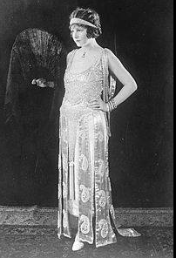

Slide 5
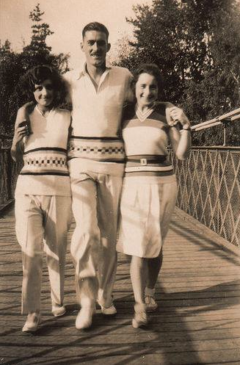

Slide 6
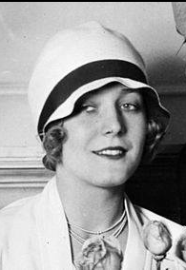

Slide 7
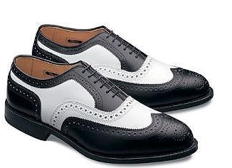
Mens fashion
Suits, ties & trousers
Two-tones shoes
Catalog shopping
Men’s hats

Slide 8
hats
Felt fedora hat
Straw hat

